Slide 1
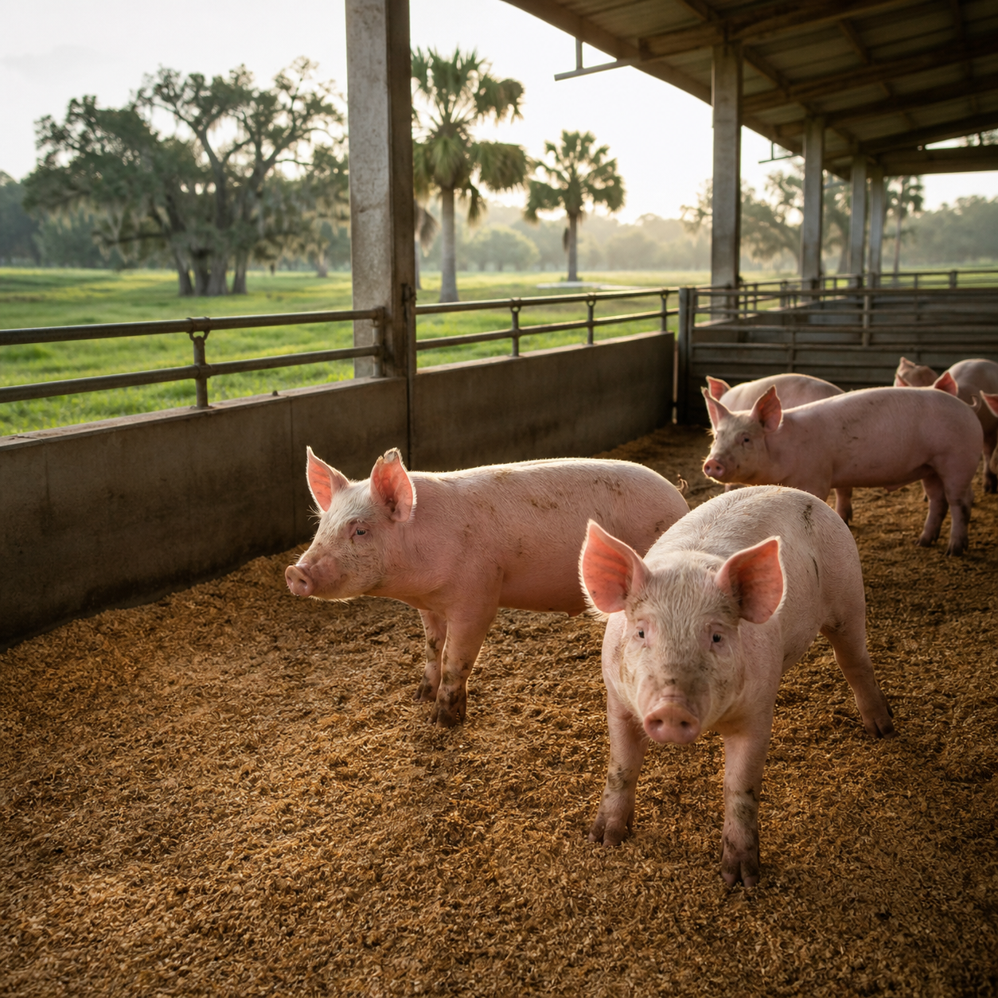
CONFIDENTIAL INVESTOR DISCUSSION • AUGUST 2026
Build Florida’s
premium feeder-pig supply
American New Wave Foods LLC
Prepared by: Noel Jimenez, DVM, MSc. CEO/Owner
(904)-678-6141
americannewwavefoods@gmail.com
A Florida breeding, fermented-feed and contract-growing platform designed to win a supply gap locally—then expand downstream.
Phase I: live 80–100 lb feeder pigs + feed mill
01
Notes:
Open with the Florida supply gap and the operating base already in place.
[Sources]
- Management information supplied by American New Wave Foods LLC, 2026-08-17.
- Cover image: AI-generated with the OpenAI image-generation tool, 2026-08-17.

Slide 2
INVESTOR DISCUSSION
A local supply gap meets an operating platform
The opportunity is not to invent demand. It is to replace imported supply with a Florida-controlled product, then compound the advantage through feed, genetics and contracted capacity.
39,000
~1,600
11%
80–100 lb pigs/year
management-estimated Florida niche demand
pigs/year
estimated current farm capacity
target reduction in feed expense
from an in-house fermented-feed mill
Management estimates; validate demand with buyer LOIs and economics with a controlled production trial.
American New Wave Foods LLC
02
Notes:
Land the three numbers, then immediately state how they will be verified.
[Sources]
- Management estimates supplied by American New Wave Foods LLC, 2026-08-17.

Slide 3
INVESTOR DISCUSSION
Today’s farm covers ~4% of the identified niche
37,400
head/year implied expansion gap
What management sees
No scaled Florida supplier offering the specified weight and quality profile.
Independent middlemen source pigs outside Florida and resell locally.
Five prospective turnkey-farm buyers create an early contract-grower pipeline; none are counted as signed demand.
Context: USDA recorded 32,196 hogs and pigs sold by Florida farms in 2022 across all classes; not directly comparable to this management-defined niche.
American New Wave Foods LLC
03
Notes:
Do not present USDA's all-class sales figure as proof of the niche estimate; use it only as market context.
[Sources]
- Management estimate: approximately 39,000 feeder pigs/year at 80–100 lb; current capacity approximately 1,600/year.
- USDA NASS 2022 Census of Agriculture, Florida Table 20–23: https://data.nass.usda.gov/Publications/AgCensus/2022/Full_Report/Volume_1%2C_Chapter_1_State_Level/Florida/st12_1_020_023.pdf

Slide 4
INVESTOR DISCUSSION
Local production removes cost from the chain
Current delivered route
American New Wave route
Out-of-state
producer
Interstate
movement
Middleman
inventory
Florida
buyer
Florida
breeding
Feed +
grow
Direct local
delivery
More miles • more handling • added resale margin • import documentation
Room to price below current delivered offers while preserving margin—subject to route-cost and buyer-price validation.
Florida import rules add permits, identification and veterinary documentation to interstate movement—friction a local supplier can avoid.
American New Wave Foods LLC
04
Notes:
Focus on controllable landed-cost advantages; do not claim a specific price spread until quotes are collected.
[Sources]
- Management observations regarding out-of-state sourcing and middlemen, 2026-08-17.
- Florida Department of Agriculture and Consumer Services, Swine Movement Requirements: https://www.fdacs.gov/Agriculture-Industry/Livestock/Animal-Movement/Swine-Movement-Requirements

Slide 5
INVESTOR DISCUSSION
Controlled feed drives quality and cost
The core know-how is a ten-year, field-developed fermented-feed formula paired with selected breeds and locally available raw materials.
01
02
03
04
Selected
genetics
Local raw
materials
Controlled
fermentation
Premium
output
Breeds chosen for carcass and eating-quality potential.
Steady, lower-cost inputs formulated to specification.
Proprietary recipe, time, pH and handling discipline.
Targeted marbling, flavor consistency and feed-cost advantage.
Investment-grade proof: side-by-side feed cost, feed conversion, mortality, carcass yield, intramuscular fat and blind sensory results.
American New Wave Foods LLC
05
Notes:
Position published research as category support, not proof that this specific formula will produce the claimed result.
[Sources]
- Management description of proprietary formula and ten-year development history, 2026-08-17.
- Zhang et al. (2025), fermented liquid feed and meat-quality outcomes: https://pubmed.ncbi.nlm.nih.gov/40606256/
- Liu et al. (2023), fermented mixed feed and carcass/meat-quality outcomes: https://pubmed.ncbi.nlm.nih.gov/36632618/
- Missotten et al. (2015), review emphasizing the importance of fermentation controls: https://pubmed.ncbi.nlm.nih.gov/25838899/

Slide 6
INVESTOR DISCUSSION
The platform is operating—not greenfield
33+
50 + 20
15+ yrs
acres ready for infrastructure expansion
gilts in place + incoming breeding pipeline
founder veterinary and production experience
Capabilities already assembled
Commercial starting point
Qualified labor for daily animal care
Livestock transport for movements and delivery
Veterinary management embedded in operations
~1,600 pigs/year estimated productive capacity
5 prospective buyers for the turnkey-farm system
Fast-cash segment reported; controls needed at scale
American New Wave Foods LLC
06
Notes:
Distinguish existing assets from signed customer commitments. The five buyers are a prospect pipeline, not contracted revenue.
[Sources]
- All operating metrics and capabilities are management-provided and not independently verified, 2026-08-17.

Slide 7
INVESTOR DISCUSSION
A breeding hub scales through contract farms
American New Wave Foods stays at the center of genetics, feed, veterinary protocols, logistics and offtake—while qualified owners add grow-out capacity.
Breeding-stock HQ
Turnkey farm
Buyback + delivery
→
→
→
Florida
buyers
Piglets • feed • veterinary protocols • scheduling
Independent owner raises company animals in an ANWF-designed system.
Company manages weight compliance, transport and delivery.
Scale lever: repeatable farm design + centralized biological and commercial control. Diligence must define mortality risk, title to animals, insurance, performance standards and buyback pricing.
American New Wave Foods LLC
07
Notes:
This model supports capital-light expansion only if contracts allocate biological, working-capital and price risk clearly.
[Sources]
- Contract-grower / turnkey-farm model described by management, 2026-08-17.

Slide 8
INVESTOR DISCUSSION
At $135/head, gross margin is 30.4–31.1%
≈31%
current gross margin
$41–42 profit/head
Fermented-feed upper bound
Cost $82.77–83.66
Profit $51.34–52.23
38.0–38.7% gross margin
if 11% applies to the full cost base
Exact new cost = current total cost − (actual feed cost × 11%). Gross profit excludes overhead, depreciation, financing, shrink and taxes.
American New Wave Foods LLC
08
Notes:
Use this slide to separate verified current economics from the fermented-feed upside. The 11% saving applies to feed expense, not automatically to total production cost.
[Sources]
- Management figures: sale price approximately $135 per 80–100 lb feeder pig; current production cost $93–94 per head with purchased feed; fermented feed targeted to reduce feed expense by approximately 11%.
- Current gross profit: $135 − $93–94 = $41–42 per head; current gross margin = $41–42 ÷ $135 = 30.37–31.11%.
- Upper-bound fermented-feed illustration: applying 11% to the full current cost base gives cost of $82.77–83.66, gross profit of $51.34–52.23 and gross margin of 38.03–38.69%.
- Exact fermented-feed economics require the feed-dollar share within the $93–94 total cost. Exact new cost = total cost − (actual feed cost × 11%).
- Gross profit excludes overhead, depreciation, financing, shrink and taxes; figures are management estimates, not a forecast.

Slide 9
INVESTOR DISCUSSION
Only Phase I underwrites the start
CORE NOW
Live 80–100 lb feeder pigs • breeding stock
ADJACENT
Turnkey farm systems • contract-growing services • fermented feed sales
OPTION VALUE
Wholesale premium pork • processing/rendering • exports and technology licensing
Sequencing discipline protects capital: prove biological performance and repeat purchase first; add processing and export complexity only after stable volume.
American New Wave Foods LLC
09
Notes:
Avoid presenting every possible revenue stream as part of the initial valuation. The live-pig and breeding-stock engine earns the right to expand.
[Sources]
- Revenue opportunities and sequencing described by management and reorganized for investor clarity, 2026-08-17.

Slide 10
INVESTOR DISCUSSION
Three phases expand share, margin and reach
PHASE I
PHASE II
PHASE III
Win liveweight
Capture local pork margin
Export the product—or the system
Scale 80–100 lb supply toward the identified Florida demand; establish breeding-stock HQ; commission the feed mill for internal production.
Use an external USDA-inspected facility for wholesale, restaurants and chains; build a case for an owned inspected facility and rendering.
Qualify country and plant requirements for Caribbean and Latin American markets; evaluate exports, licensing and technology transfer.
Regulatory gate: commercial meat requires inspection; export eligibility and certification are country- and establishment-specific.
American New Wave Foods LLC
10
Notes:
Keep Phase III framed as market qualification, not as a secured export channel.
[Sources]
- USDA FSIS, Inspection of Meat Products: https://www.fsis.usda.gov/inspection/inspection-programs/inspection-meat-products
- USDA FSIS, Export Guidance: https://www.fsis.usda.gov/inspection/import-export/export-guidance
- USDA FSIS, Import & Export Library: https://www.fsis.usda.gov/inspection/import-export/import-export-library
- Management phase plan, 2026-08-17.

Slide 11
INVESTOR DISCUSSION
Founder proposal: a starting point
What the term sheet must define
Illustrative founder proposal
Capital + uses: scope, funding and working capital
Return waterfall: recoupment, distributions and reserves
Governance: authority, budgets, reporting and deadlock
IP protection: formula ownership/license and improvements
Transfer pricing: feed, piglets, transport and veterinary services
Future rights: wholesale, exports, feed, licensing and territory
50 / 50
participation in liveweight and local pig-market economics
40%
investor share of feed-mill net profit
Processing, export, external feed sales and technology-transfer economics to be negotiated separately.
Structure should follow the capital plan—not precede it.
American New Wave Foods LLC
11
Notes:
Invite the investor to shape a durable structure. Avoid finalizing percentages before the capital stack, IP and governance are clear.
[Sources]
- Founder-proposed economic split supplied by management, 2026-08-17.
- This slide is a discussion framework, not legal, tax, accounting or investment advice.

Slide 12
THE DECISION
Back a 90-day proof package
before Phase I deployment
Decision requested
1
Align on Phase I scope and diligence access
Convert founder intelligence into an investable data room and a milestone-based capital plan.
2
Approve engineering, feed-mill and working-capital quotes
01
Demand
Buyer interviews, delivered-price evidence and LOIs covering a meaningful share of the 39,000-head estimate.
02
Production
Breeding/output plan, biosecurity review, capacity map and contractor operating agreement.
3
Draft a milestone-based term sheet once evidence is complete
03
Economics
Controlled feed trial, bill of materials, mill quotes, unit economics, working capital and downside cases.
Capital amount: set from verified Phase I scope and vendor quotes.
American New Wave Foods LLC
12
Notes:
Close on the next decision—not on a generic thank-you. The initial ask is alignment on evidence, scope and structure.
[Sources]
- Diligence milestones synthesized from management claims and external regulatory requirements, 2026-08-17.
- USDA FSIS inspection and export sources cited on slide 10.

